Slide 1

SPORTS CLUB MANAGEMENT SYSTEM
By Aishwarya Pawar

Slide 2
Problem Statement :
In today’s fast-paced world, sports clubs need an efficient system to manage their members, coaches, and activities seamlessly. Our goal is to design a SQL-based Sports Club Management System that organizes all club operations digitally
Objectives Of Sports Club :
Efficient Data Management – Maintain accurate records of members, coaches, sports, and events in a structured database.
Membership Tracking – Monitor member details, joining dates, subscriptions, and enrolled sports.
Coach & Sport Allocation – Assign coaches to respective sports and keep track of their responsibilities.
Event & Tournament Management – Record participation, schedules, and results of sports events.
Report Generation – Provide useful insights such as most popular sports, active members, and membership statistics.
Data Integrity & Security – Ensure information is consistent, accurate, and protected using SQL constraints (Primary Keys, Foreign Keys).

Slide 3
📊 Dataset Overview – Sports Club Management System :
The Sports Club database is designed to manage information about members, sports, coaches, and memberships. It helps the club keep track of who has joined, which sports they play, who coaches them, and their membership details.
✨ Key Features :
Stores member details (name, age, gender, join date).
Maintains list of sports offered (indoor & outdoor).
Keeps coach details with experience and assigned sport.
Tracks memberships with type, fee, and start date.
Defines relationships between members, sports, coaches, and memberships.
Supports data analysis using aggregate functions and SQL queries.
Contains 100 records per table → Members, Sports, Coaches, Memberships.
Scalable for managing more members and sports in future.

Slide 4
SPORTS CLUB
SQL Quries

Slide 5
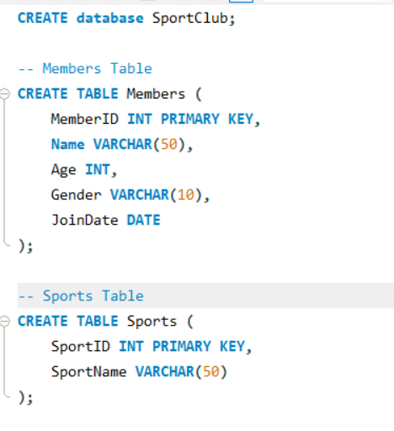
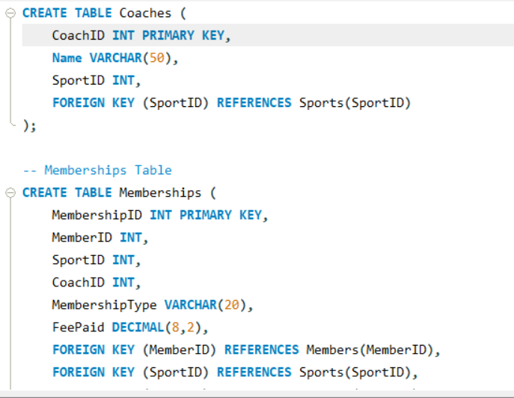

Slide 6


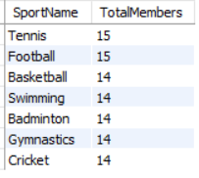
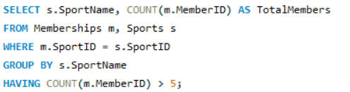
1 . Count number of members in each gender group.
2. Show sports that have more than 5 members enrolled.

Slide 7
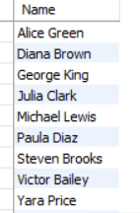
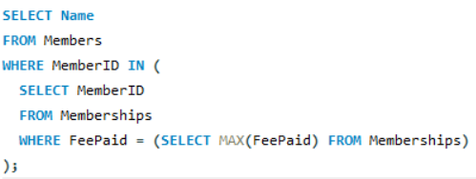
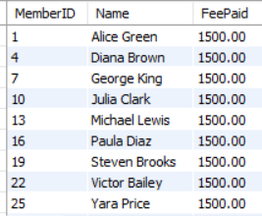
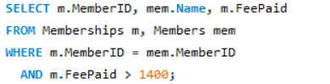
3. Show members who paid the highest fee.
4. List members who paid more than 1400 in fees.

Slide 8
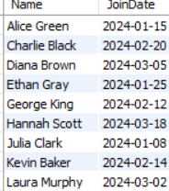

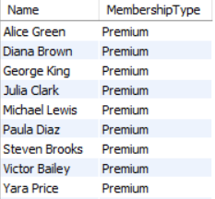
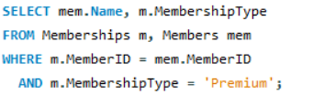
5. Show all members who joined in 2024.
6. Find members who have "Premium" membership.

Slide 9
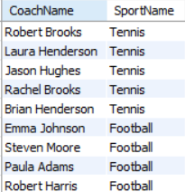
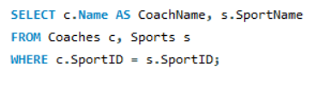
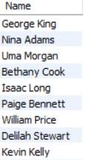
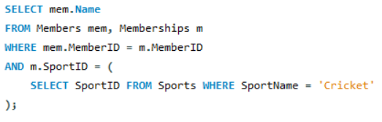
7. Show coaches and the sport name they coach.
8. Find Members who joined 'Cricket'.

Slide 10
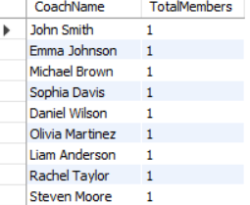
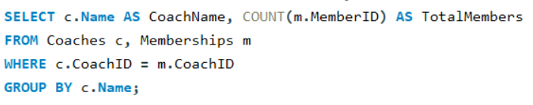
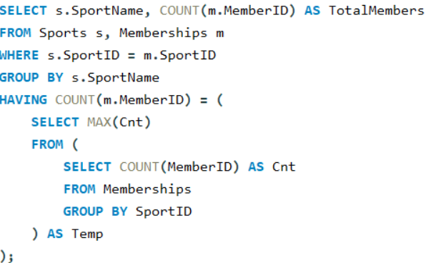

9. Coaches with number of Members they handle.
10. Find the sport with maximum members.

Slide 11
THANK YOU

